Slide 1
INT331
UNIT -5

Slide 2
What is Ansible?
Ansible is an open-source platform used for automation and for various operations such as configuration management, application deployment, task automation, and IT orchestration.
Ansible is easy to set up, and it is efficient, reliable, and powerful. It runs on Linux, Mac, or BSD.
Apart from the free version, it has an enterprise edition called ‘Ansible Tower.’
The hectic tasks such as configuration management, task automation, etc. were previously carried out through some traditional practices, so why do we need Ansible?

Slide 3
Why do we need Ansible?
Let’s consider a case where you as a System Admin is responsible for handling a company’s infrastructure.
Suppose, there are nine servers, out of which five are acting as web servers and the rest four as database servers.
You want to install Tomcat on web servers and MySQL on database servers.
In the traditional method, you will have to manage the servers manually, install the required software, and change the configurations, along with administering the services on each server individually.

Slide 4
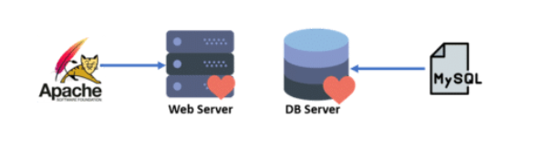
.
When there are only a few services and configuration requirements, it will be easy for you to handle these amounts of servers; even if When there are only a few services and configuration requirements, When there are only a few services and configuration requirements, it will be easy for you to handle these amounts of servers; even if there is a minimal increment in the services, you can still handle the situation by provisioning a few more servers to maintain the infrastructure.
As we know, research and inventions never stop; technology keeps on enhancing. New features and services are introduced every other day, and the hosted applications become more complex with the increased amount of services.
As the number of services starts to increase, the same task must be repeated multiple times. As sysadmins provision more servers, it gets more difficult for them to set up, update, and maintain all these servers manually.

Slide 5
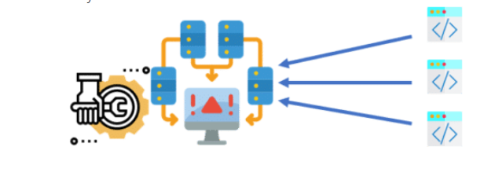

Slide 6
In most cases, sys admins won’t be able to set up each server identically.
Also, such processes would end up hampering the velocity of the work for developers as the development team is agile and is always releasing software frequently.
On the other hand, the sysadmins would have to spend extra time on system configurations and managing the infrastructure.

Slide 7
This is where Ansible comes to the rescue!
Key Terms in Ansible
Controller Machine: This is where Ansible gets installed. The controller machine helps in enabling provisioning on servers we manage.
Inventory: This is basically an initializing file that contains information about the servers that we are managing.
Playbook: It is an organized unit of scripts defining an automated work for the configuration management of our server.
Task: A task block defines a single procedure to be executed on the server like installing packages.
Handlers: Handlers in Ansible are event-driven actions that execute specific tasks when triggered, ensuring precise and efficient responses within your automation workflows.
Roles: Roles in Ansible are like pre-packaged sets of instructions and configurations, simplifying complex automation tasks and ensuring consistency across projects.
Variables: In Ansible, variables act as dynamic substitutes, allowing you to customize automation by storing and manipulating data within playbooks and roles, enhancing adaptability to different system configurations.
Modules: Modules in Ansible are task-specific tools that help automate various actions on remote servers, simplifying the execution of tasks like software installation, file management, and more.

Slide 8
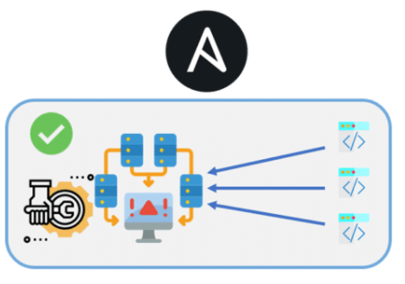

Slide 9
Ansible Workflow
As discussed above, when services increase, sysadmins will provision more servers to do configuration management.
They need not do it manually anymore but install Ansible on the master node where they need to write the code into the Ansible playbook to describe the setup, installation process, and configuration required for these servers.
_x000b_

Slide 10
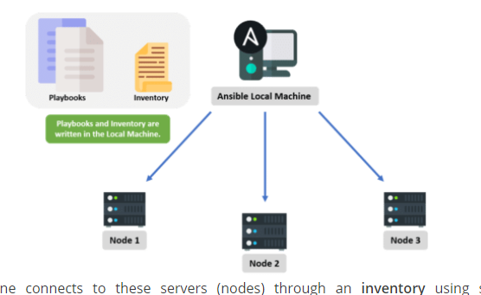

Slide 11
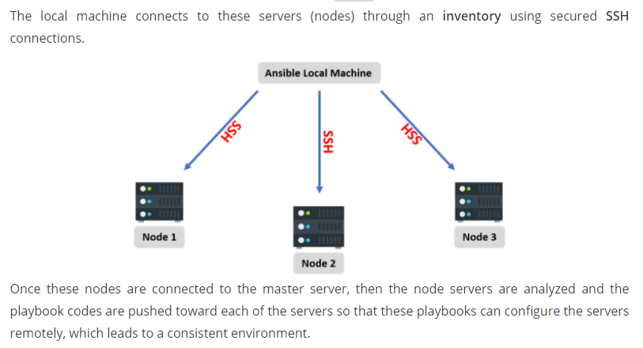

Slide 12
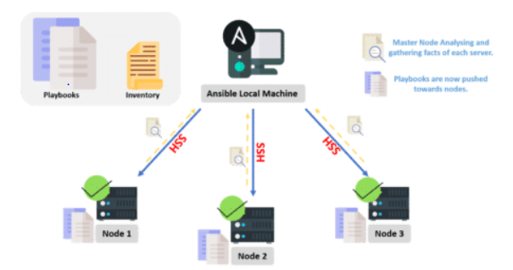
Once these nodes are connected to the master server, then the node servers are analyzed and the playbook codes are pushed toward each of the servers so that these playbooks can configure the servers remotely, which leads to a consistent environment.

Slide 13
Ansible Architecture
From the diagram below it is clear that Ansible Orchestration Engine interacts with a user who is writing the Ansible playbook to execute Ansible Orchestration Engine, along with interacting with the services of public/private cloud and configuration management database.

Slide 14
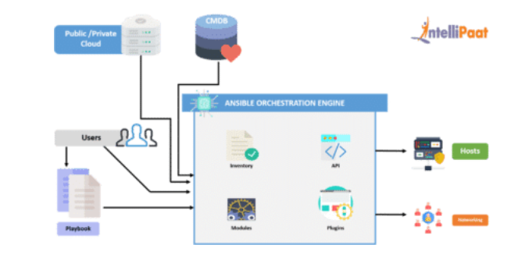

Slide 15
Modules
Ansible connects the nodes and pushes out small ‘Ansible Modules.’ Modules are executed by Ansible and then get removed when finished. These modules can reside on any machine; no servers or daemons or databases are required here. We can work with the text editor of our choice or a terminal and a version control system to keep track of the changes made in our content.
Plugins
A plugin is a piece of code that expands the core functionality of Ansible. There are plenty of handy plugins, and we can write our own plugins as well.

Slide 16
Inventory
We already discussed this in the Ansible Terminologies section. An inventory is a list of hosts/nodes, having IP addresses, servers, databases, etc., which need to be managed.
Playbooks
As discussed earlier, we write our code in a playbook. It is simple and written in the YAML format and basically describes tasks that are supposed to be executed through Ansible. We can launch tasks synchronously or asynchronously with playbooks.

Slide 17
APIs
Ansible APIs work as transport for cloud services, either public or private.
Hosts
Hosts are basically the node systems in the Ansible architecture getting automated by Ansible only. They can be any type of machine such as Windows, Red Hat, Linux, etc.

Slide 18
Networking
We can use Ansible to automate different networks. It uses the easy, simple, yet powerful, agentless automation framework for IT operations and development. It uses a type of data model (playbook or role), which is separated from the Ansible Automation Engine that spans across different network hardware quite easily.
CMDB
CMDB is a type of repository that acts as a data warehouse for the IT installations.

Slide 19
Cloud
A network of remote servers on which we can store, manage, and process our data. These servers are hosted on the Internet. For storing the data remotely rather than on local servers, we would just launch our resources and instances on the cloud and connect them to our servers, and we would have the wisdom of operating our task remotely.
Now that we understand the workflow of Ansible, along with its architecture, let’s sneak a peek over some of its benefits.

Slide 20
Benefits of Using Ansible
Agentless: As long as a connection can be SSHed and it has Python, it can be configured with Ansible; no agent/software or additional firewall ports are required to install on our client or host systems for automation. Also, we don’t have to worry about setting up and managing the infrastructure.
Simple: As we’ve seen, Ansible uses a very simple syntax written in YAML known as playbooks—YAML (Yet Another Markup Language) is a human-readable data serialization language. We don’t need special coding skills to code and understand playbooks. It is very easy to install and execute tasks in order.
Modular: Ansible is modular as we require only one program per script. This way, we can spread our programs across different servers.

Slide 21
Efficient: Not requiring any extra software on our servers means that there is more space for our resources.
Powerful and flexible: Having powerful features gives us the capability to model even complex IT workflows in lesser time, along with managing infrastructure, networks, operating systems, and services that are already in use.

Slide 22
Operations by Ansible
So far, we have figured out how reliable and efficient Ansible is. Now, we will learn about the type of operations Ansible can perform.
Configuration Management
In the field of operations by Ansible, ‘Configuration Management’ stands out as a key pillar. It refers to the process of maintaining, adjusting, and controlling the configuration options of your servers and IT infrastructure. Ansible makes this complex task simple to perform. Using playbooks, you can define and enforce the desired state of your servers, ensuring they match your predefined configurations. Whether it’s setting up software, tweaking system parameters, or managing user accounts, Ansible’s Configuration Management capabilities provide a reliable, automated way to keep your systems in balance with your organizational needs. This approach not only saves time but also reduces errors, making it an essential tool in the Ansible toolkit.

Slide 23
Resource/Server Provisioning
Whether we are booting/starting servers/virtual machines or creating cloud instances from various templates, Ansible is always there to help us with the smooth running of the process. Ansible makes sure to provide the required packages installed on our application.

Slide 24

Application Deployment
With Ansible, we can define our application and manage its deployment. Instead of performing the deployment steps one by one, we just need to install Ansible on our machine and it will do the same tasks for us, even in lesser time. Provided those tasks are listed in our Ansible playbook, Ansible executes them in order.

Slide 25
Security and Compliance
With Ansible, we can easily configure our security details. We do it once in a control machine and the same security details will be spread across all the other nodes.
Orchestration
We can also perform the orchestration of our application using Ansible. Ansible provides orchestration by aligning the business requests with the application, data, and infrastructure. It creates an application-aligned infrastructure that can be scaled up or down based on the needs.
Now that we understand ‘What is Ansible?,’ its workflow, its terminologies, its architecture, and the different operations performed by Ansible, let’s head on to set up its environment.

Slide 26
THANKS

